Slide 1
5 IP as the IoT Network Layer
Yuemin Ding
Tecnun School of Engineering
University of Navarra

Slide 2
Outlines
Introduction to IP
Optimizing IP for IoT
Header Compression
6Lo Working Group and 6TiSCH
RPL routing

Slide 3
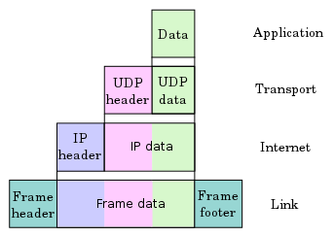
Introduction to IP
The IP architecture (https://www.rfc-editor.org/info/rfc791) has been used for 40 years and demonstrated success to integrate small and large evolutions.
Key advantages of Internet Protocol (IP):
Open and standards-based
Versatile
Ubiquitous
Scalable
Manageable and highly secure
Stable and resilient
Consumers’ market adoption
The innovation factor

Slide 4
Introduction to IP
IP has been applied in data centers, cloud services, operation centers, PCs, mobile phones, etc.
The use of IP in the last mile (IoT devices) is more complicated and difficult.
For the integration of the IoT, a model of two, adaptation and adoption, can be used:
Adaptation: rely on gateways to ensure the translation between non-IP and IP layers
Adoption: replacing all non-IP layers with their IP layer counterparts, simplifying the deployment model and operations.

Slide 5
Needs of IP Optimization
- Constrained Nodes
Devices that are very constrained in resources, may communicate infrequently to transmit a few bytes and may have limited security and management capabilities → adaption model with a gateway
Devices with enough power and capacities to implement a stripped-down IP stack or non-IP stack → either an adaption or adoption model (optimized IP)
Devices that are similar to generic PCs in terms of computing and power resources but have constrained networking capacities, such as bandwidth → adoption model (full IP)

Slide 6
Needs of IP Optimization
- Constrained Networks
Constrained networks are often referred to as low-power and lossy networks (LLNs).
Low-power → battery powered or energy harvesting
Low-bandwidth links → a few kbps or hundred kbps
Lossy → network unreliability caused by disruptions in the data flow or packet loss.
One of the golden rules in a constrained network is to “underreact to failure.”
A constrained network that overreacts can lead to a network collapse, such as retransmission
Both constrained nodes and networks pose major challenges for IoT connectivity and protocols optimization

Slide 7
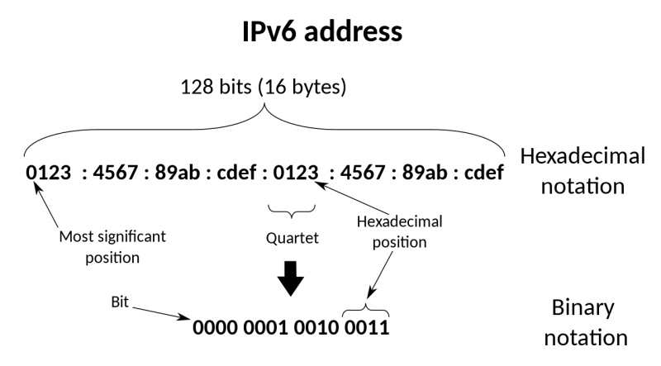
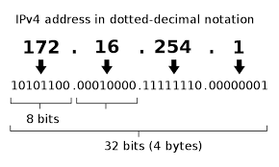
IP versions (4 v.s. 6)
The IETF has been working on transitioning the Internet from IP version 4 to IP version 6
Motivation: the lack of address space in IPv4 especially in the era of IoT

Slide 8
IP versions (4 v.s. 6)
At present, which version to use? Can be complex:
Application Protocol → SCADA protocols such as DNP3/IP (IEEE 1815), Modbus TCP, or the IEC 60870-5-104 standards are specified only for IPv4
Cellular Provider and Technology → GPRS, Edge, and 3G are defined based on IPv4; 4G/LTE networks, data services can use IPv4 or IPv6 as a base protocol
Serial Communications: Encapsulation of serial protocols over IP leverages mechanisms such as raw socket TCP or UDP. Raw socket sessions can run over both IPv4 and IPv6.
IPv6 Adaptation Layer: Newer technologies, such as IEEE 802.15.4 (Wireless Personal Area Network), IEEE 1901.2, and ITU G.9903 (Narrowband Power Line Communications) only have an IPv6 adaptation layer specified

Slide 9
Outlines
Introduction to IP
Optimizing IP for IoT
Header Compression
6Lo Working Group and 6TiSCH
RPL routing

Slide 10
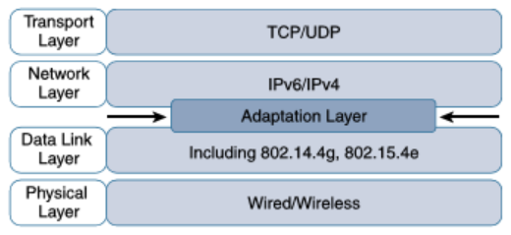
Optimizing IP for IoT
Adaption layer → the model for packaging IP into lower-layer protocols
RFC 864 describes how an IPv4 packet gets encapsulated over an Ethernet frame
RFC 2464 describes how the same function is performed for an IPv6 packet

Slide 11
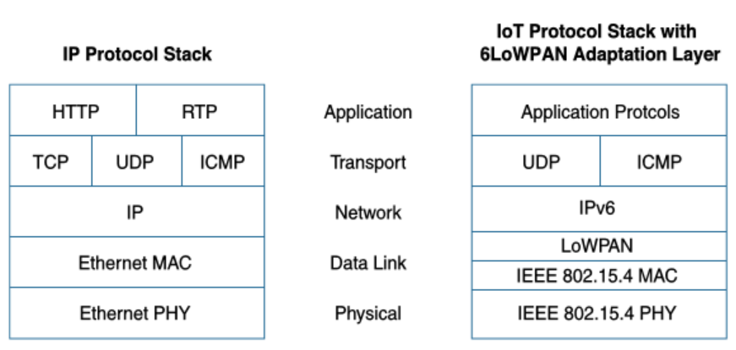
Optimizing IP for IoT
Comparison of an IoT Protocol Stack Utilizing 6LoWPAN and an IP Protocol Stack

Slide 12
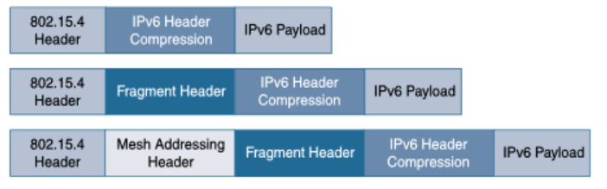
Optimizing IP for IoT
Header Compression
RFC 4994 is foundational defining frame headers for the capabilities of header compression, fragmentation, and mesh addressing.
6LoWPAN Header Stacks

Slide 13
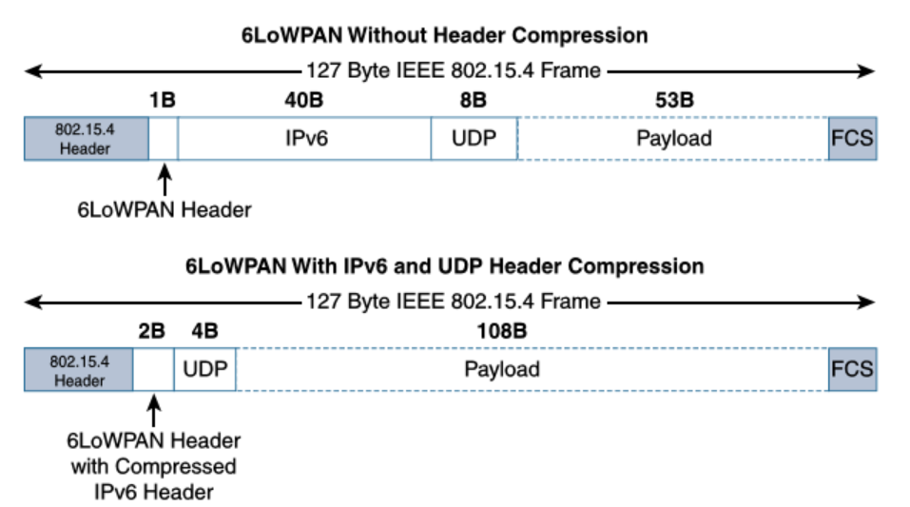
Optimizing IP for IoT
Header compression
IPv6 header compression was defined initially in RFC 4944 and subsequently updated by RFC 6282.
The size of IPv6’s 40-byte headers and User Datagram Protocol’s (UDP’s) 8-byte headers → minimum 6 bytes combined in some cases.

Slide 14
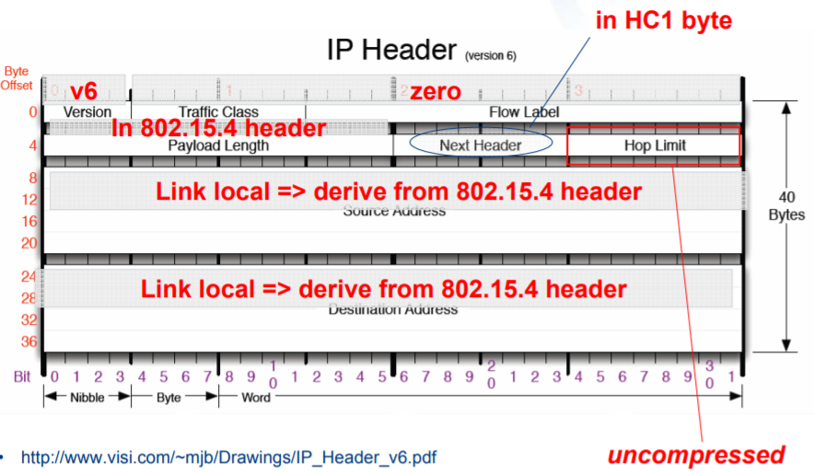
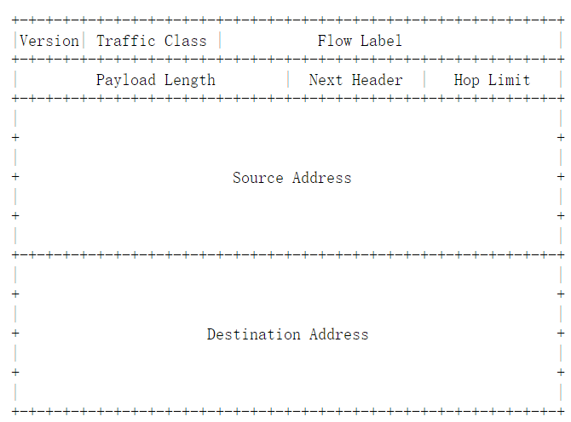
Optimizing IP for IoT
Header compression
IPv6 header

Slide 15
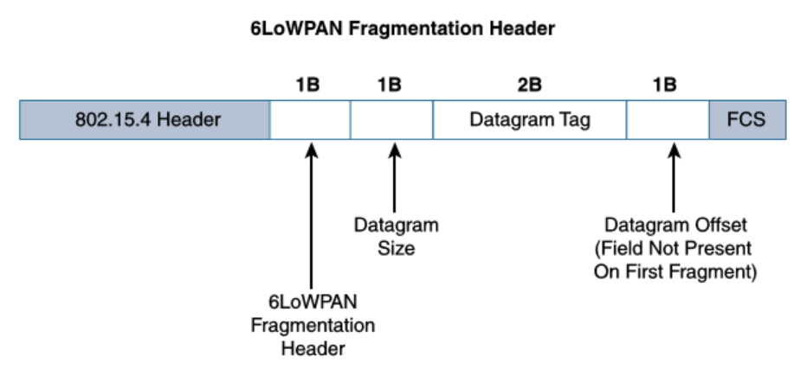
Optimizing IP for IoT
Fragmentation
The maximum transmission unit (MTU) for an IPv6 network must be at least 1280 bytes.
For IEEE 802.15.4, 127 bytes is the MTU.
Large IPv6 packets must be fragmented across multiple 802.15.4 frames at Layer 2.

Slide 16
Optimizing IP for IoT
Fragmentation
Datagram Size → the total size of the unfragmented payload.
Datagram Tag → the set of fragments for a payload (All fragments of an IPv6 packet have the same datagram tag).
Datagram Offset → how far into a payload a particular fragment occurs (not present for the first fragment since the value is 0).

Slide 17
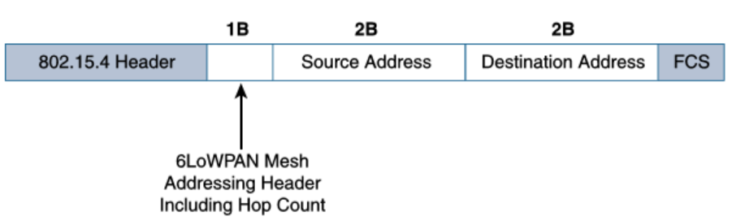
Optimizing IP for IoT
Mesh Addressing
The purpose of the 6LoWPAN mesh addressing function is to forward packets over multiple hops.
Three fields are defined for this header: Hop Limit, Source Address, and Destination Address.
Each hop decrements this value by 1 as it is forwarded. Once the value hits 0, it is dropped and no longer forwarded

Slide 18
Optimizing IP for IoT
Mesh Addressing
Mesh addressing header is used in a single IP subnet and is a Layer 2 type of routing known as mesh-under.
The Source Address and Destination Address fields for mesh addressing are IEEE 802.15.4 addresses indicating the endpoints of an IP hop.

Slide 19
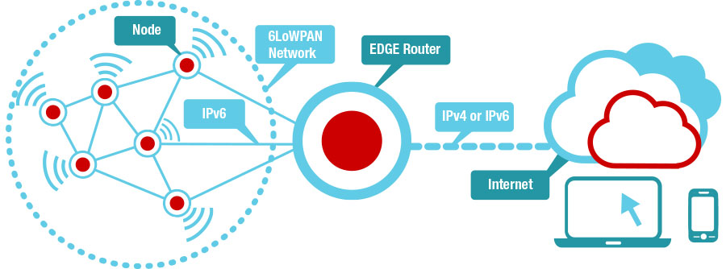
Optimizing IP for IoT
Mesh-Under v.s. Mesh-Over Routing
Mesh-Under routing
Layer 2 routing, the routing of packets is handled at the 6LoWPAN adaptation layer
The term mesh-under is used because multiple link-layer hops can be used to complete a single IP hop
An edge gateway terminates the mesh-under domain.
Source: zolertia.io

Slide 20
Optimizing IP for IoT
Mesh-Under v.s. Mesh-Over Routing
Mesh-Over routing
IP Layer 3 routing is utilized to forward the packets to their destination, either inside or outside the mesh domain.
Each full-functioning node acts as an IP router
When a network has been implemented using different link-layer technologies, a mesh-over routing setup is useful.
Source: zolertia.io

Slide 21
Outlines
Introduction to IP
Optimizing IP for IoT
Header Compression
6Lo Working Group and 6TiSCH
RPL routing

Slide 22
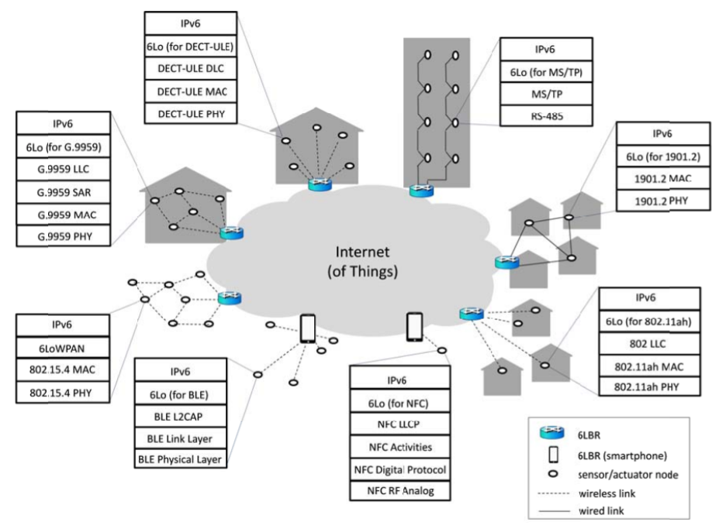
Optimizing IP for IoT
- 6Lo Working Group
The 6LoWPAN working group initially focused its optimizations on IEEE 802.15.4 LLNs.
Standardizing IPv6 over other link-layer technologies is still needed → 6Lo Working Group
Carles Gomez, etc., From 6LoWPAN to 6Lo: Expanding the Universe of IPv6-Supported Technologies for the Internet of Things, IEEE Communications Magazine, vol. 55, pp. 148-155, 2017.

Slide 23
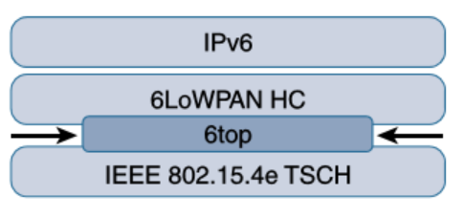
Optimizing IP for IoT
- 6TiSCH
To standardize IPv6 over the TSCH mode of IEEE 802.15.4e, the IETF formed the 6TiSCH working group.
This allows the programming of predictable transmissions and enables deterministic, industrial-type applications.
6top, a sublayer that glues together the MAC layer and 6LoWPAN adaptation layer over IEEE 802.15.4e, is defined.

Slide 24
Optimizing IP for IoT
- 6TiSCH
This sublayer provides commands to the upper network layers.
These commands enable functionalities including network layer routing decisions, configuration, and control procedures for 6TiSCH schedule management.

Slide 25
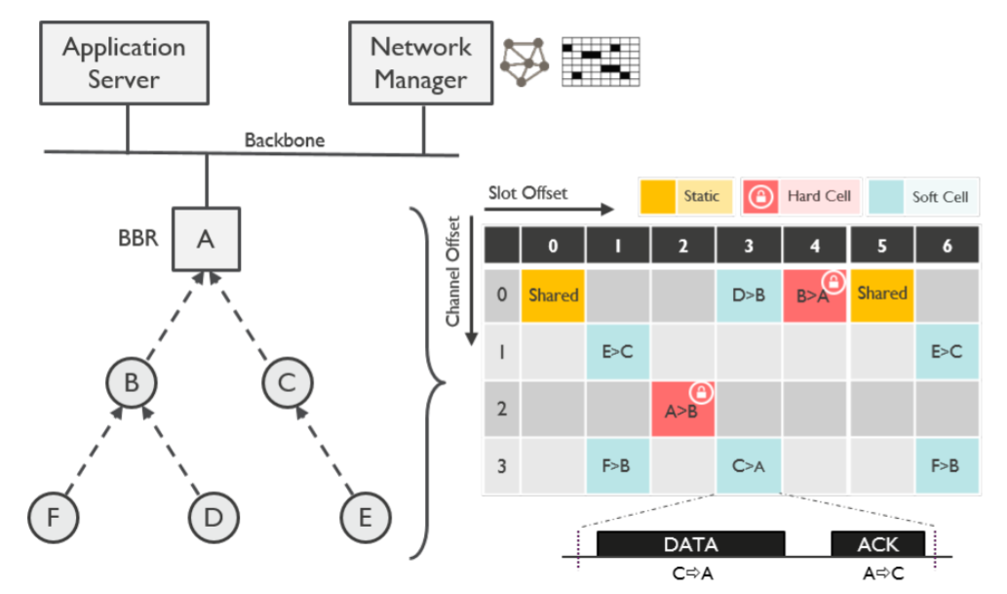
Optimizing IP for IoT
- 6TiSCH
The 6TiSCH architecture defines four schedule management mechanisms:
Static scheduling: All nodes in the constrained network share a fixed schedule.
Neighbor-to-neighbor scheduling: A schedule is established that correlates with the observed number of transmissions between nodes.
Karaagac, A. & De Poorter, E. & Hoebeke, J. (2019). In-Band Network Telemetry in Industrial Wireless Sensor Networks. IEEE Transactions on Network and Service Management. PP. 1-1. 10.1109/TNSM.2019.2949509.

Slide 26

Optimizing IP for IoT
- 6TiSCH
The 6TiSCH architecture defines four schedule management mechanisms:
Remote monitoring and scheduling management: Time slots and other resource allocation are handled by a management entity that can be multiple hops away.
Hop-by-hop scheduling: A node reserves a path to a destination node multiple hops away
Karaagac, A. & De Poorter, E. & Hoebeke, J. (2019). In-Band Network Telemetry in Industrial Wireless Sensor Networks. IEEE Transactions on Network and Service Management. PP. 1-1. 10.1109/TNSM.2019.2949509.

Slide 27
Outlines
Introduction to IP
Optimizing IP for IoT
Header Compression
6Lo Working Group and 6TiSCH
RPL routing

Slide 28
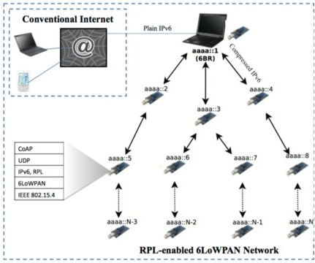
Optimizing IP for IoT
- RPL
RPL (IPv6 Routing Protocol for LLNs) is a new distance-vector routing protocol.
RPL is defined by the IETF RoLL (Routing over LLNs) working group.
RPL is Layer 3 (IP layer) routing protocol and no information is required from the MAC layer to perform routing

Slide 29
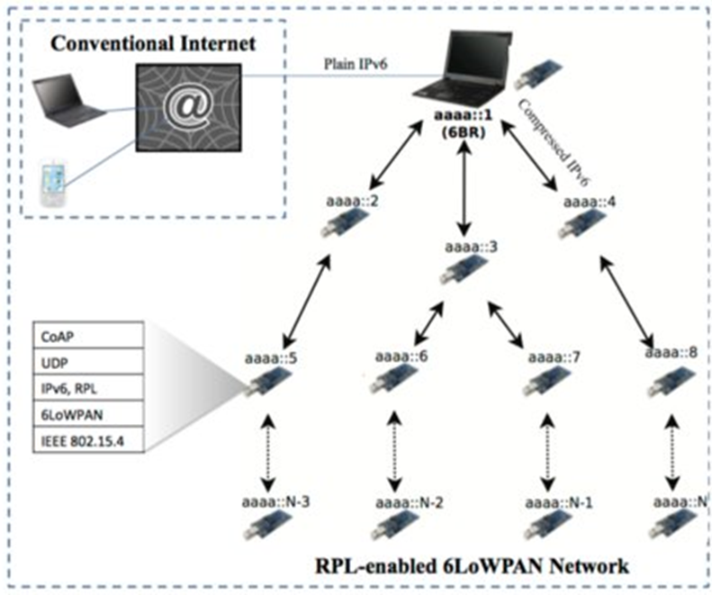
Optimizing IP for IoT
- RPL
To cope with the constrained resources, two modes are defined:
Storing mode → All nodes contain the full routing table of the RPL domain.
Non-storing mode → Only the border router(s) of the RPL domain contain(s) the full routing table. All other nodes in the domain only maintain their list of parents.

Slide 30
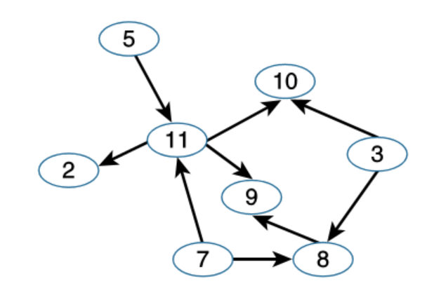
Optimizing IP for IoT
- RPL
RPL is based on the concept of a directed acyclic graph (DAG)
A DAG is a directed graph where no cycles exist (from any vertex or point in the graph, you cannot follow an edge or a line back to this same point).

Slide 31
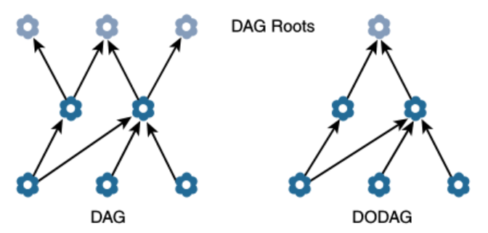
Optimizing IP for IoT
- RPL
A basic RPL process involves building a destination-oriented directed acyclic graph (DODAG)
A DAG has multiple roots, whereas the DODAG has just one
In a DODAG, each node maintains up to three parents that provide a path to the root.
DAG and DODAG Comparison

Slide 32
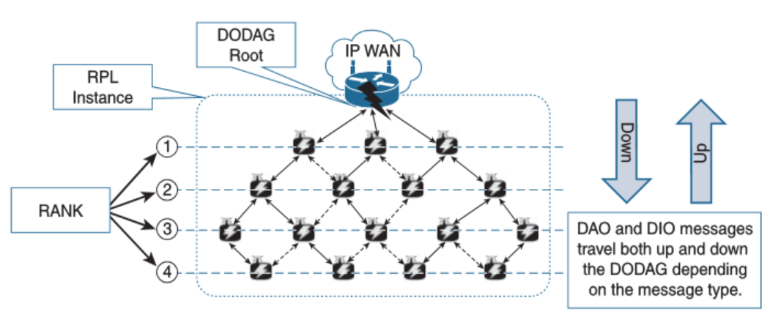
Optimizing IP for IoT
- RPL
Upward routes in RPL are discovered and configured using DAG Information Object (DIO) messages.
Downward routes are established by advertising their parents toward the DODAG using a Destination Advertisement Object (DAO) message.

Slide 33
Optimizing IP for IoT
- RPL
For non-storing mode:
Nodes sending DAO messages directly to the DODAG root (border router)
Only the root stores the routing information.
All packets must go up to the root to get a route for moving downstream.

Slide 34
Optimizing IP for IoT
- RPL
For storing mode:
Each node keeps track of the routing information that is advertised in the DAO messages.
The nodes can make their own routing decisions, not necessarily pass the root (edge router).

Slide 35
Optimizing IP for IoT
- RPL
Objective Function (OF)→An objective function (OF) defines how metrics are used to select routes and establish a node’s rank.
The rank → a rough approximation of how “close” a node is to the root and helps avoid routing loops (nodes may decrease their rank whenever they have established lower-cost routes).

Slide 36
Optimizing IP for IoT
- RPL
Routing metrics:
Expected Transmission Count (ETX)
Hop Count
Latency
Link Quality Level
Node Energy
Throughput
Etc.

Slide 37
Summary
Introduction to IP
Optimizing IP for IoT
Header Compression
6Lo Working Group and 6TiSCH
RPL routing

Slide 38
Thank you!
Q&A

